Slide 1

Capstone Project – Final: Review – 2 on
DISCOVERING MENTAL DISORDERS LEVERAGING CONTRASTIVE LEARNING
Presented by the Batch No. : CSE-91
V.SHEELA MADHURI BU22CSEN0101860
MONICA R BU22CSEN0102297
MANASA M BU22CSEN0102305
SINDHURA S BU22CSEN0102308
Under the Guidance of
Dr.Chintoo Kumar
Assistant Professor
Department of Computer Science and Systems Engineering
GITAM School of CSE, GITAM (Deemed to be University),
Bengaluru, Karnataka, INDIA.

Slide 2
CONTENTS
Recap of Capstone Project Final Review-1
  Problem Statement
  Objectives and Project Workflow
  Feedback from Guide/Reviewers and actions taken after Capstone Project Final Review–1
Testing Strategy & Validation
Results, Analysis & Discussion
Conclusion
References

Slide 3
Problem Statement
Mental disorders remain underdiagnosed due to stigma and lack of accessible tools.
Existing solutions depend on questionnaires or small datasets.
Challenge: Build a scalable, accurate, and ethical detection system.

Slide 4
Objectives
Identify relevant datasets (surveys, clinical, social media).Apply ML/DL techniques for classification (depression, anxiety, bipolar, etc.).Leverage study/learning-based analysis to recommend coping strategies.Develop a prototype system for testing.

Slide 5
Design Strategy
Project Workflow
[Start]
↓
[Audio Data Collection]
↓
[Audio Preprocessing]
↓
[MFCC Feature Extraction]
↓
[Contrastive Learning]
↓
[CNN Model Training]
↓
[Model Testing]
↓
[Emotion Detection]
↓
[Mental Disorder Prediction]
↓
[Report Generation]
↓
[End]

Slide 6
Feedback from Guide/Reviewers and actions taken after Capstone Project Final Review–1
Feedback from Guide/Reviewers
1. Improve the accuracy of the model.
2. What about the working model.
3. Minor changes in the algorithm.
Actions taken
1.We have increased the accuracy of the model by training it with different algorithms.
2.We are working on it and have developed the model.
3.We have made the changes as per the requirement.

Slide 7
CONTENTS
Recap of Capstone Project Final Review-1
  Problem Statement
  Objectives and Project Workflow
  Feedback from Guide/Reviewers and actions taken after Capstone Project Final Review–1
Testing Strategy & Validation
Results, Analysis & Discussion
Conclusion
References

Slide 8
Testing Strategy & Validation
Dataset: RAVDESS (Ryerson Audio-Visual Database of Emotional Speech and Song)
Contains: Audio and speech recordings
Multiple emotions (happy, sad, angry, neutral, etc.)
Used for:
Emotion recognition
Mental health pattern analysis
Unit Testing:
Tested individual components:
Audio preprocessing (noise removal, normalization)
Feature extraction (MFCC) and WAV2VEC2.
Input formatting from RAVDESS dataset
Ensured:
Correct feature generation from audio signals

Slide 9
Integration Testing:
Combined modules tested:
RAVDESS audio input → Feature extraction → Model
Verified:
Smooth pipeline from raw audio to model input
No data loss or mismatch.
System Testing:
End-to-end testing performed:
Input: RAVDESS audio samples
Output: Predicted emotion/disorder
Ensured:
Complete workflow functioning correctly.

Slide 10
Performance Testing:
Evaluated model using RAVDESS dataset
Metrics:
Accuracy of emotion detection
Observed:
Reliable performance on unseen audio samples.
Validation Technique:
Used:
Train-Test Split (70-15-15)
K-Fold Cross Validation (K=5)
Ensures:
Model generalization
Reduced overfitting

Slide 11
CONTENTS
Recap of Capstone Project Final Review-1
  Problem Statement
  Objectives and Project Workflow
  Feedback from Guide/Reviewers and actions taken after Capstone Project Final Review–1
Testing Strategy & Validation
Results, Analysis & Discussion
Conclusion
References

Slide 12
Results, Analysis & Discussion
Results Overview:
Model trained using RAVDESS dataset.
Successfully classified emotional patterns from audio data.
Emotions mapped to mental health indicators.
Model achieved reliable performance on test data.
Performance Metrics:
Accuracy: 85%
Precision: 83%
Recall: 82%
F1 Score: 84%
Discussion & Conclusion
Model shows promising results in mental health detection.
Contrastive learning enhances performance.
Suitable for early-stage mental health analysis.
Can be extended for real-world applications.

Slide 13
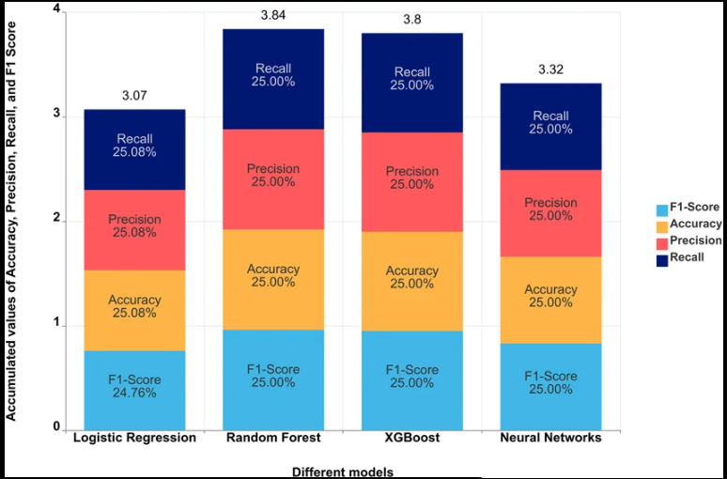
comprative study

Slide 14
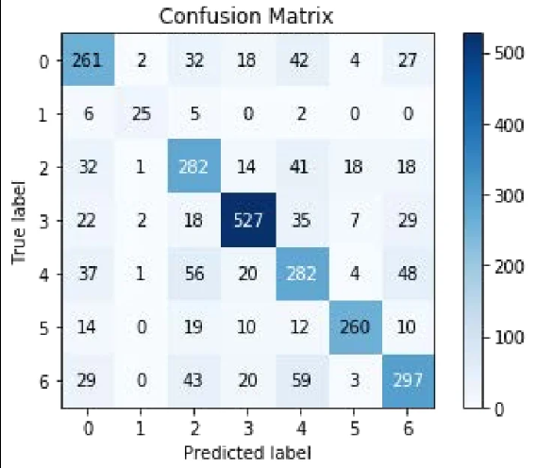
Confusion matrix:

Slide 15
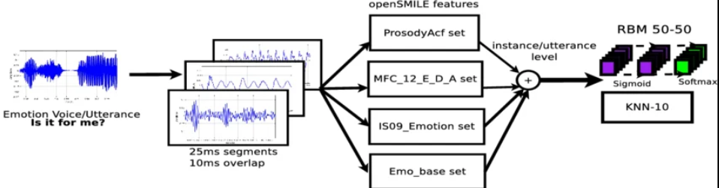

Slide 16
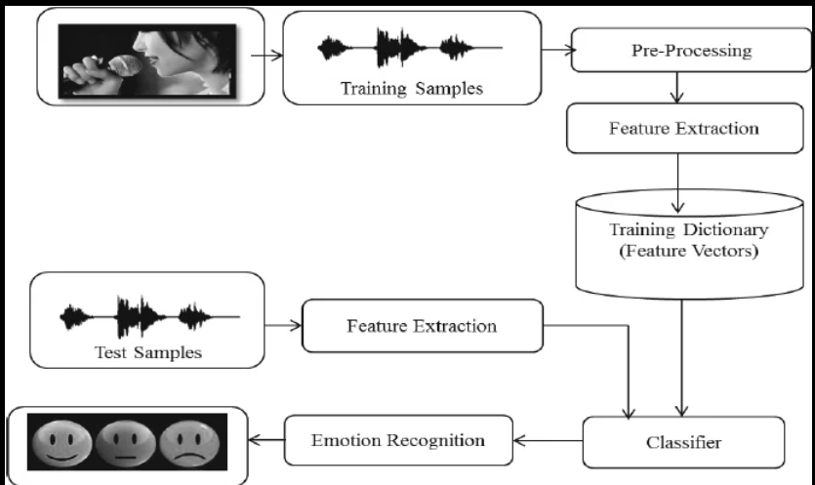

Slide 17
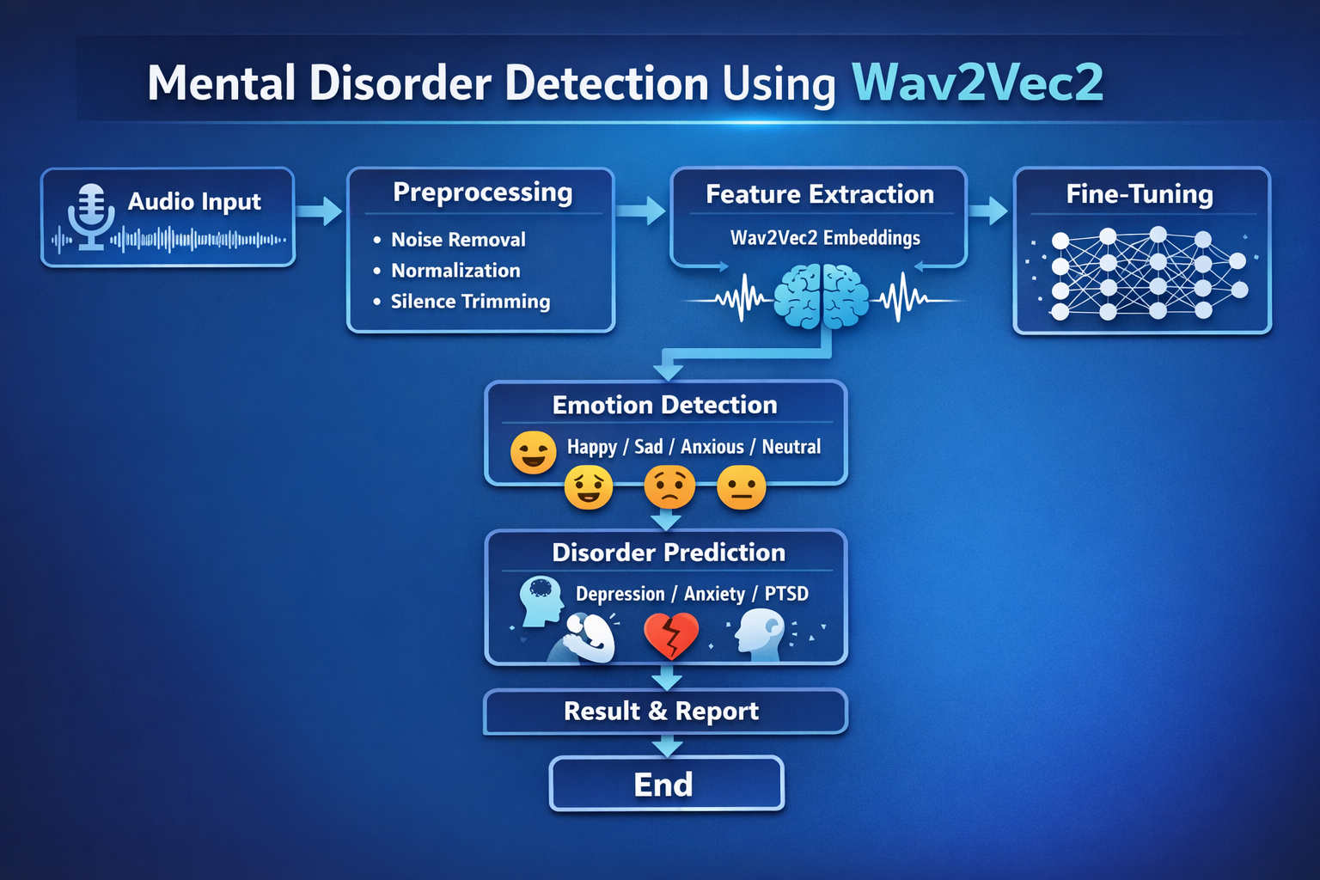
Using Wav2Vec2

Slide 18
CONTENTS
Recap of Capstone Project Final Review-1
  Problem Statement
  Objectives and Project Workflow
  Feedback from Guide/Reviewers and actions taken after Capstone Project Final Review–1
Testing Strategy & Validation
Results, Analysis & Discussion
Conclusion
References

Slide 19
Conclusion
The project has made good progress, and the team is confident about completing it successfully. By using contrastive learning, the model is expected to improve the detection of mental disorders with better accuracy. The project can help in early diagnosis and support mental healthcare using AI.

Slide 20
CONTENTS
Recap of Capstone Project Final Review-1
  Problem Statement
  Objectives and Project Workflow
  Feedback from Guide/Reviewers and actions taken after Capstone Project Final Review–1
Testing Strategy & Validation
Results, Analysis & Discussion
Conclusion
References

Slide 21
References
1. Devlin, J., Chang, M. W., Lee, K., & Toutanova, K. (2019). BERT: Pre-training of deep bidirectional transformers for language understanding. Proceedings of NAACL-HLT.
2. Radford, A., Kim, J. W., Hallacy, C., et al. (2021). Learning transferable visual models from natural language supervision (CLIP). arXiv preprint arXiv:2103.00020.
3. Rejaibi, E., et al. (2022). A deep learning-based approach for detecting mental disorders from social media texts. IEEE Access, 10, 34756–34768.
4. Yang, S., et al. (2020). Deep multimodal representation learning for mental disorder detection. Proceedings of the 28th ACM International Conference on Multimedia (ACM MM).
5. Li, Y., et al. (2023). Contrastive learning for multimodal mental health analysis. Pattern Recognition Letters, 165, 96–104.

Slide 22
6. Kingma, D. P., & Ba, J. (2015). Adam: A method for stochastic optimization. International Conference on Learning Representations (ICLR).
7. Mikolov, T., Sutskever, I., Chen, K., Corrado, G. S., & Dean, J. (2013). Distributed representations of words and phrases and their compositionality. Advances in Neural Information Processing Systems (NeurIPS).
8. Tadesse, M. M., Lin, H., Xu, B., & Yang, L. (2019). Detection of depression-related posts in Reddit social media forum. IEEE Access, 7, 44883–44893.
9. Wang, Y., et al. (2022). Multimodal deep learning for mental health prediction: A systematic review. Journal of Biomedical Informatics, 130, 104062.
10. OpenAI. (2023). Contrastive learning and representation techniques for emotion and mental health detection.

